Slide 1
Applying CNN for Razorback Logo Classification
Course: DASC 41103 — Machine Learning Team: Group 5 Your Name(s): Jaxon Ham, Cody Uhl

Slide 2
Project Overview
Goal: Develop a CNN to classify images as Official Razorback Logo (1) vs Not Razorback (0).
Dataset
Custom-built dataset of Razorback_Images/ and Non_Razorback_Images/
Classification problem with strong visual variability
Required preprocessing (resize to 500×500, augmentation)
Deliverables
Train/validation/test splits
CNN architecture
Evaluation results
Reflections & recommendation

Slide 3
Dataset Creation
How dataset was built:
Manually curated two folders:
Razorback_Images/ → official logo merchandise, branding, licensed graphics
Non_Razorback_Images/ → random images with similar shapes/colors
Ensured consistent .jpg format
Applied preprocessing and augmentation:
Resize (500×500), rotation, flips, normalization
Dataset split:
70% Train
15% Validation
15% Test

Slide 4
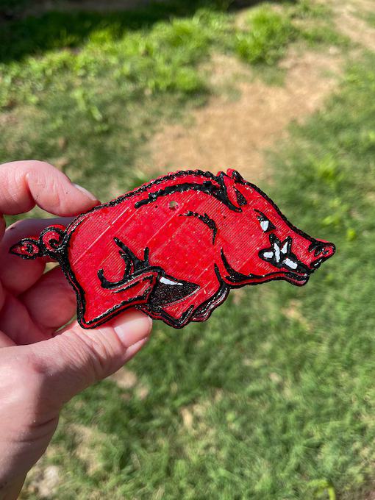
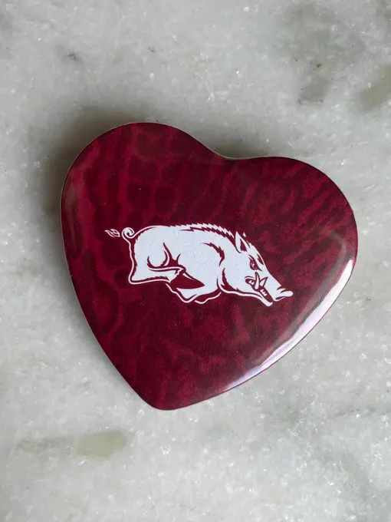

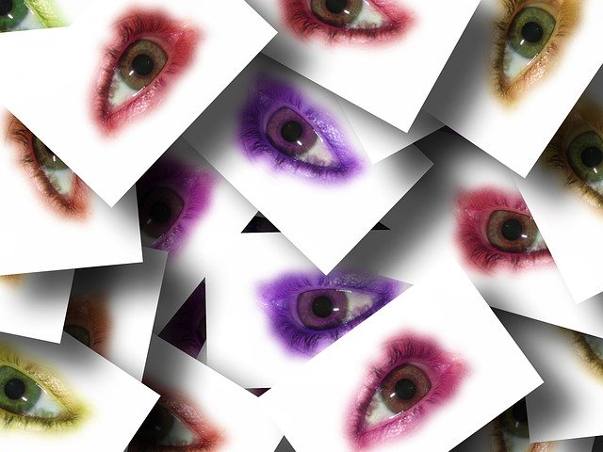
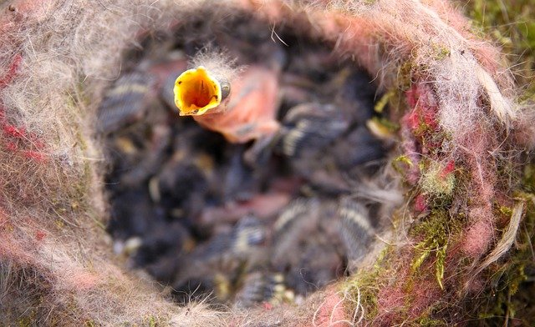
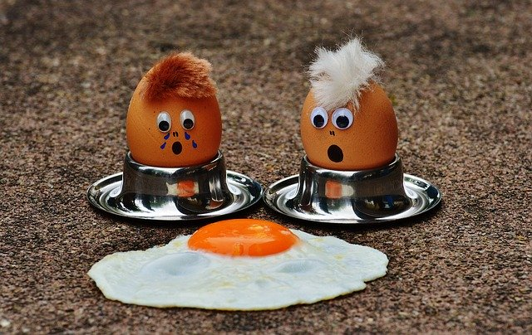
Example Images
Razorback samples:
Non-Razorback Samples:

Slide 5
Final CNN Architecture
Layers:
4× Conv → ReLU → MaxPool blocks
Flatten
Fully Connected (128 units + dropout)
Output layer: Sigmoid (binary classifier)
Reasons for choosing architecture:
Matches assignment requirements
500×500 images need multiple conv layers to extract features
Max pooling reduces dimensionality
Dropout reduces overfitting
Simple enough to train quickly on CPU/GPU

Slide 6
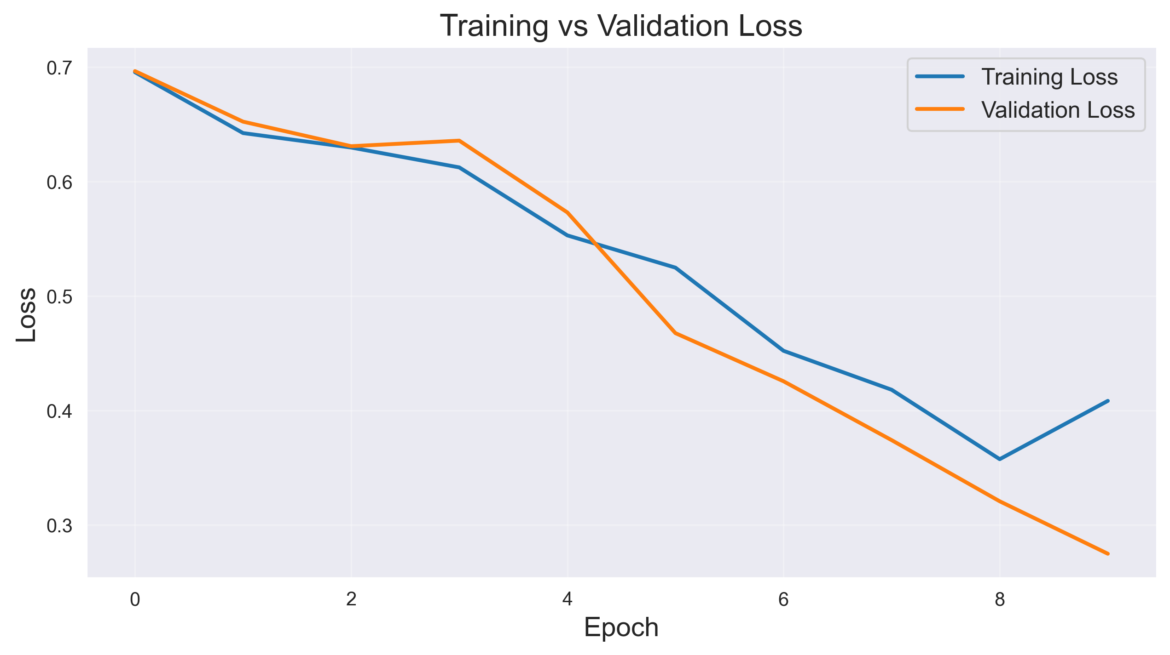
Training & Validation Loss

Slide 7
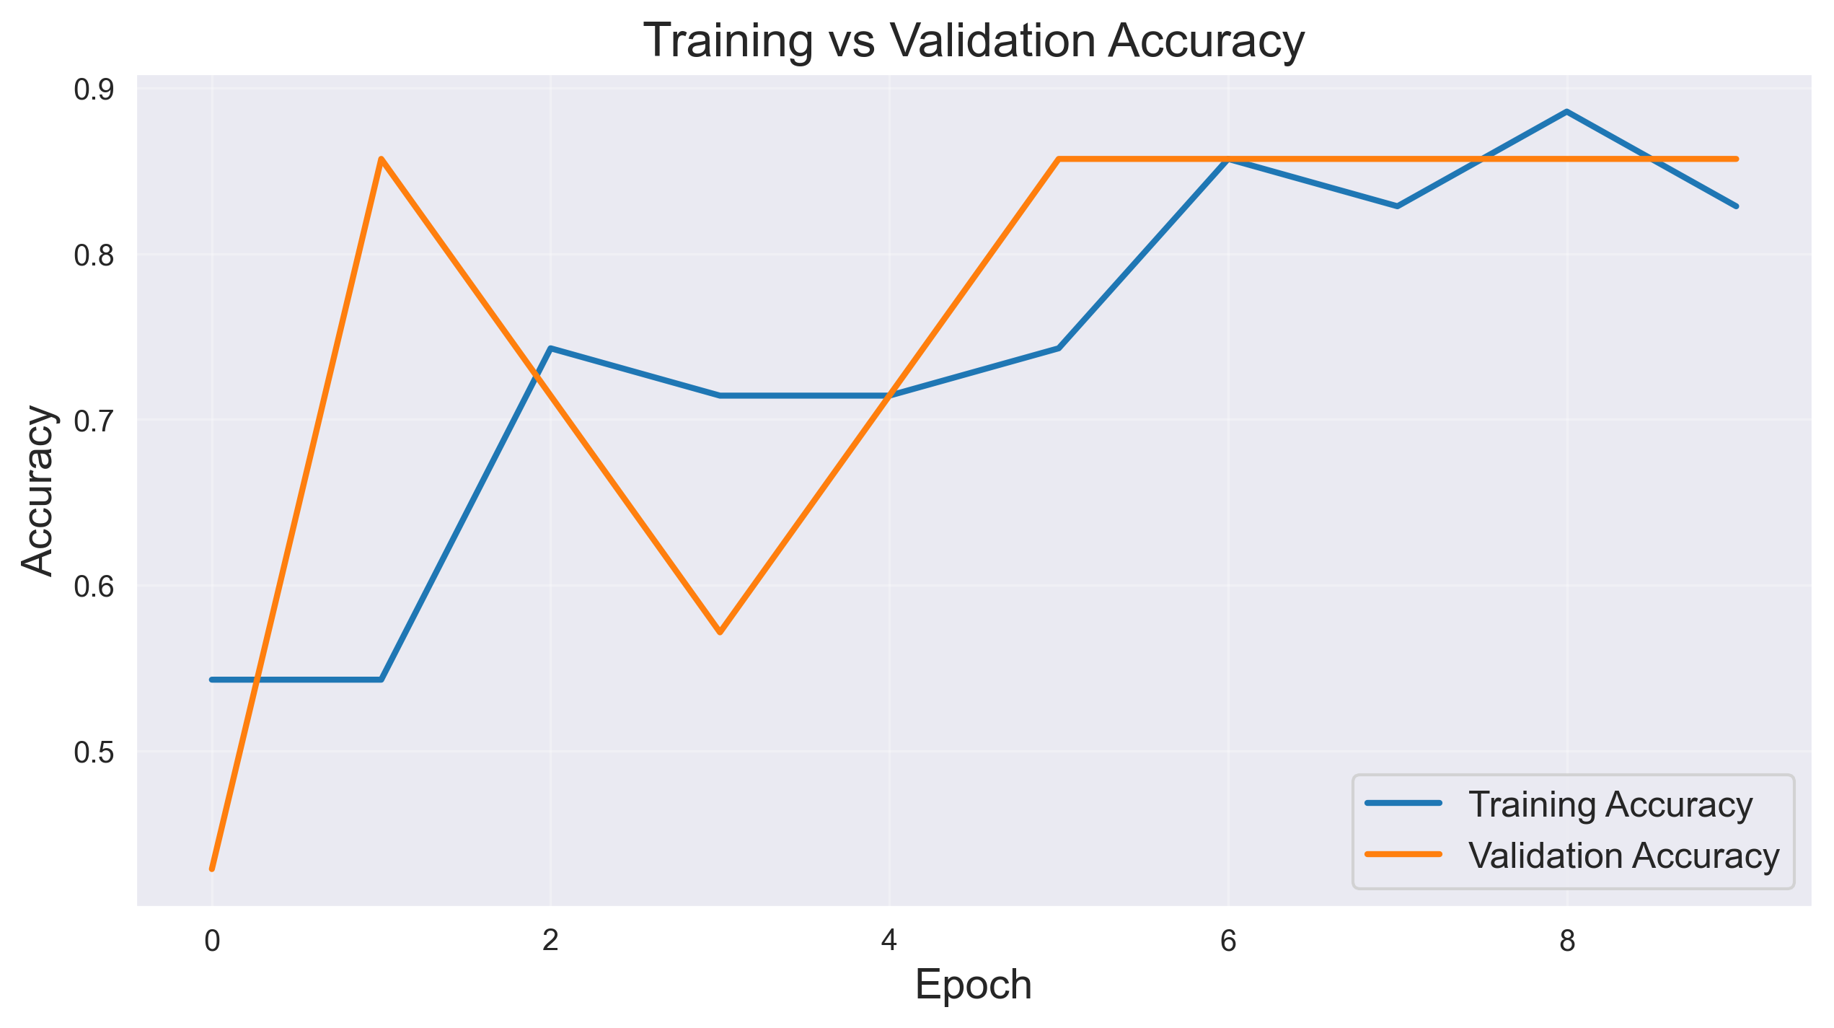
Training & Validation Accuracy

Slide 8
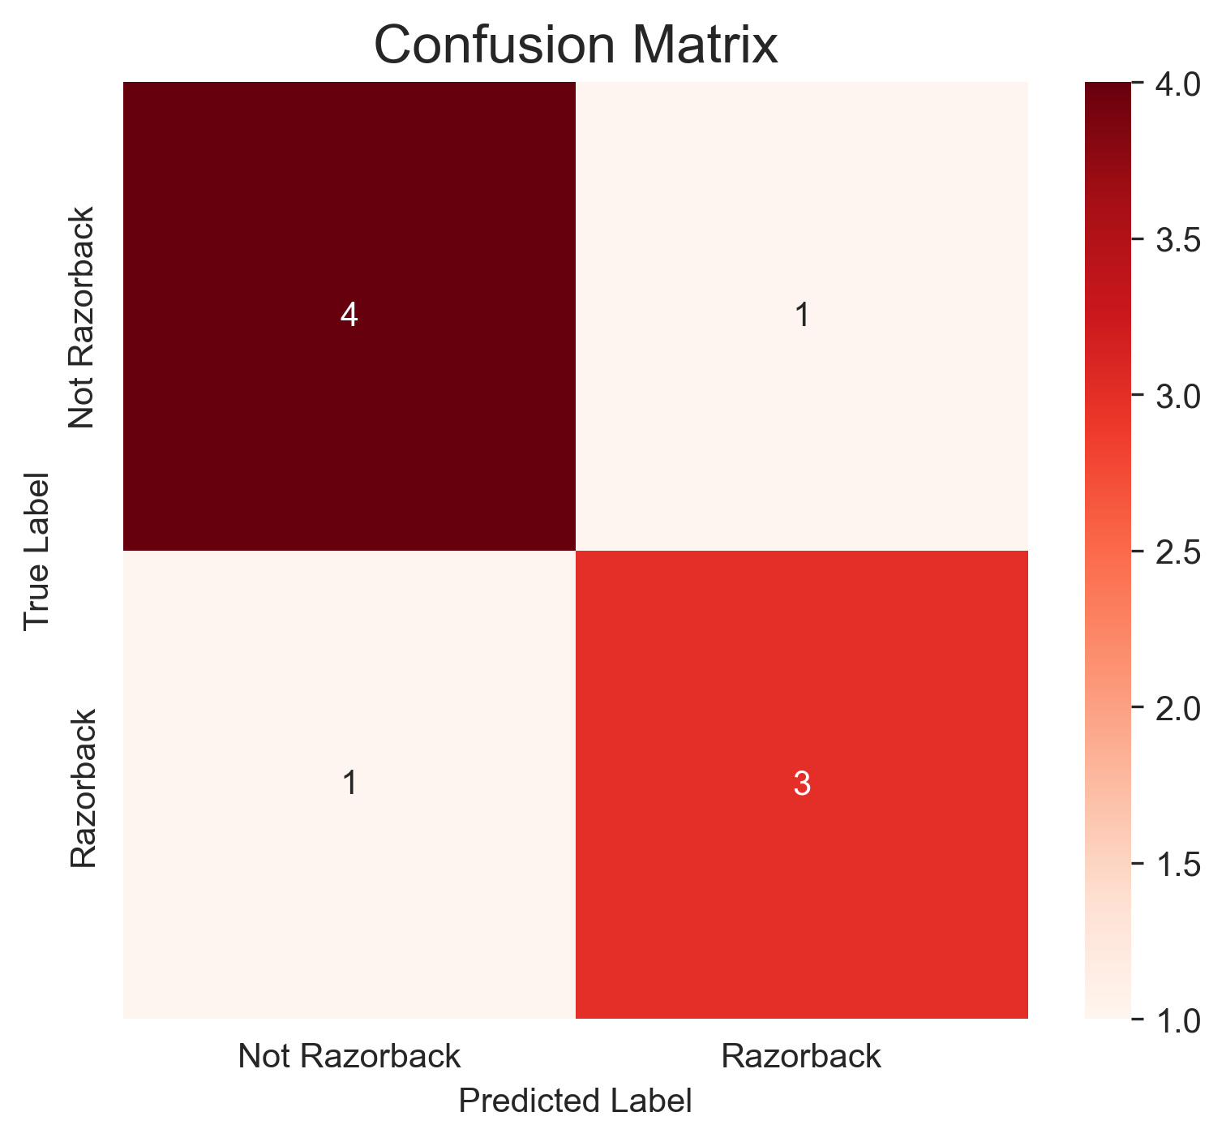
Confusion Matrix

Slide 9
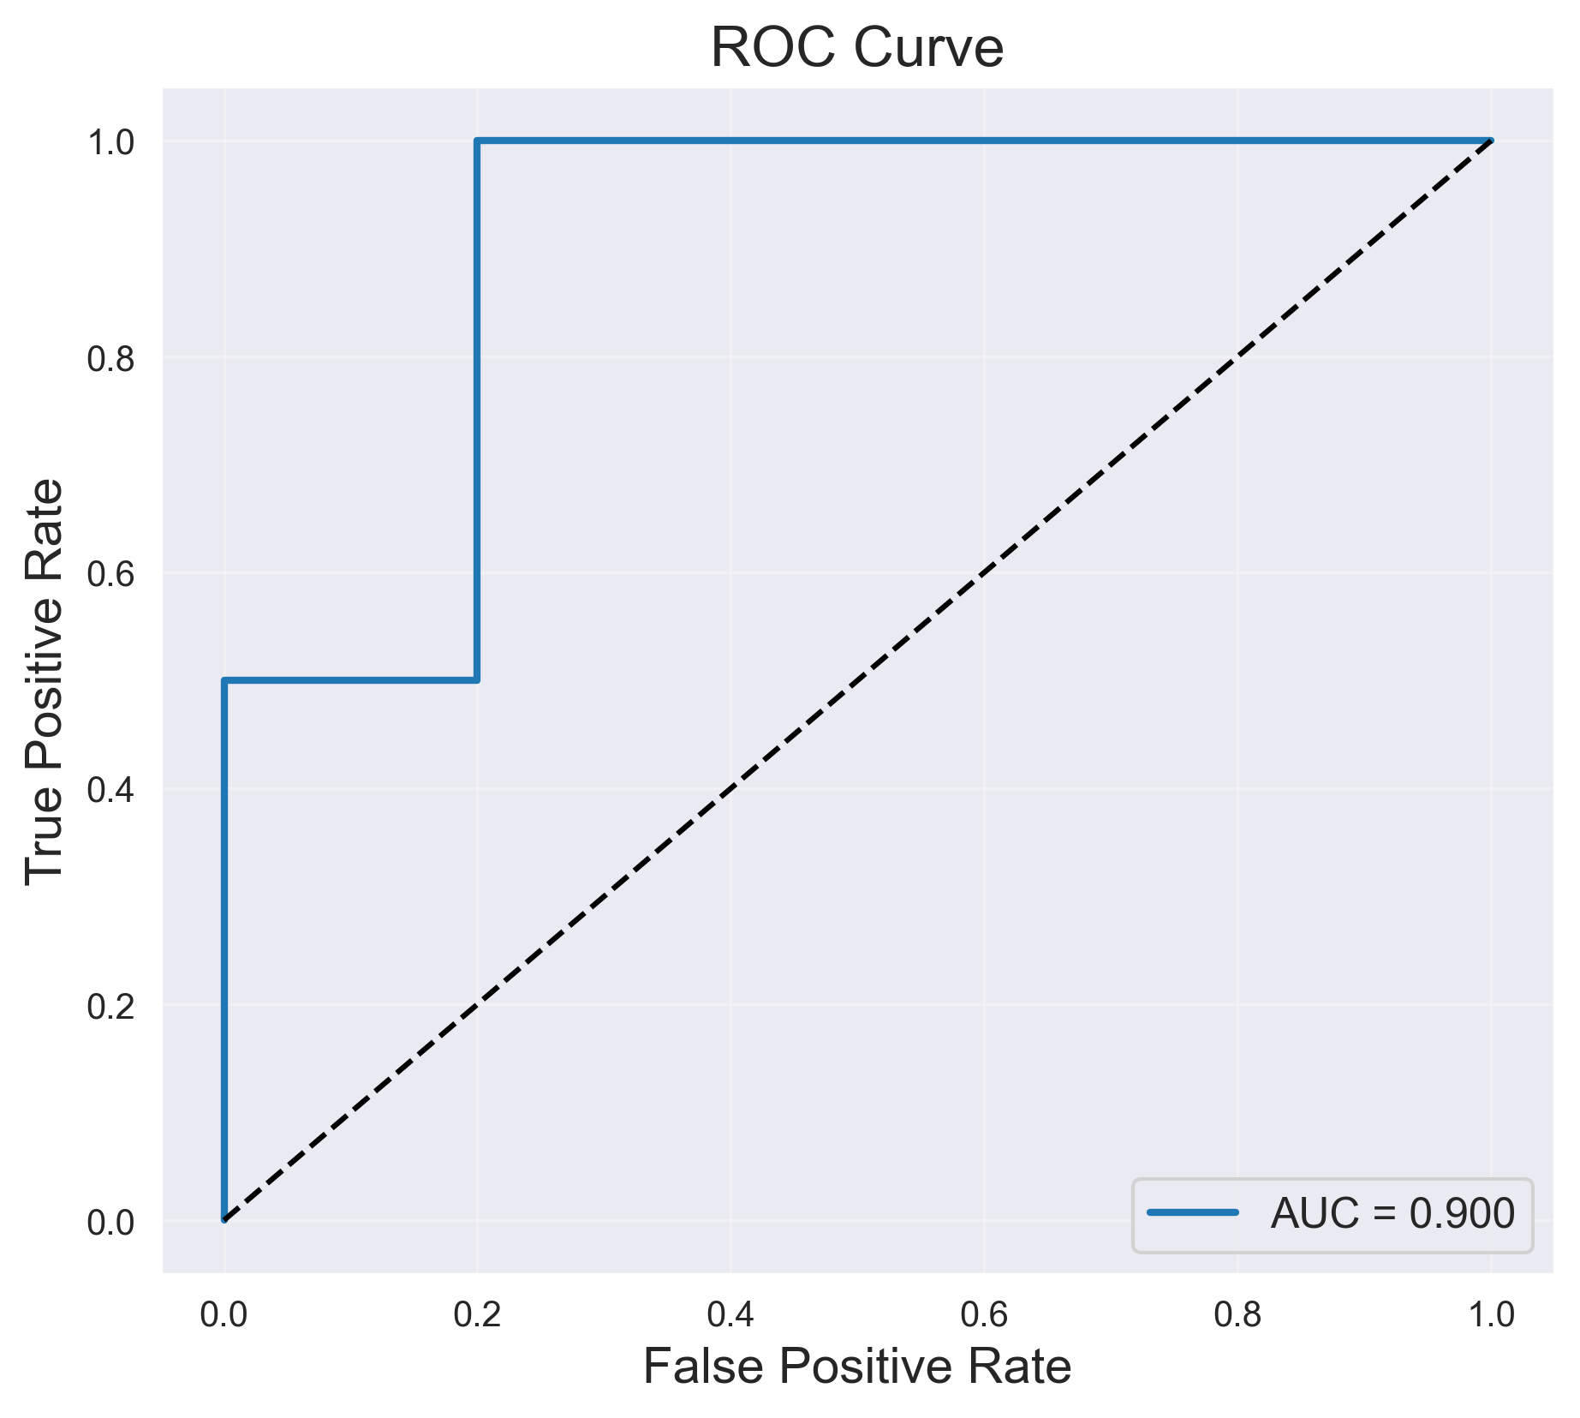
ROC Curve

Slide 10
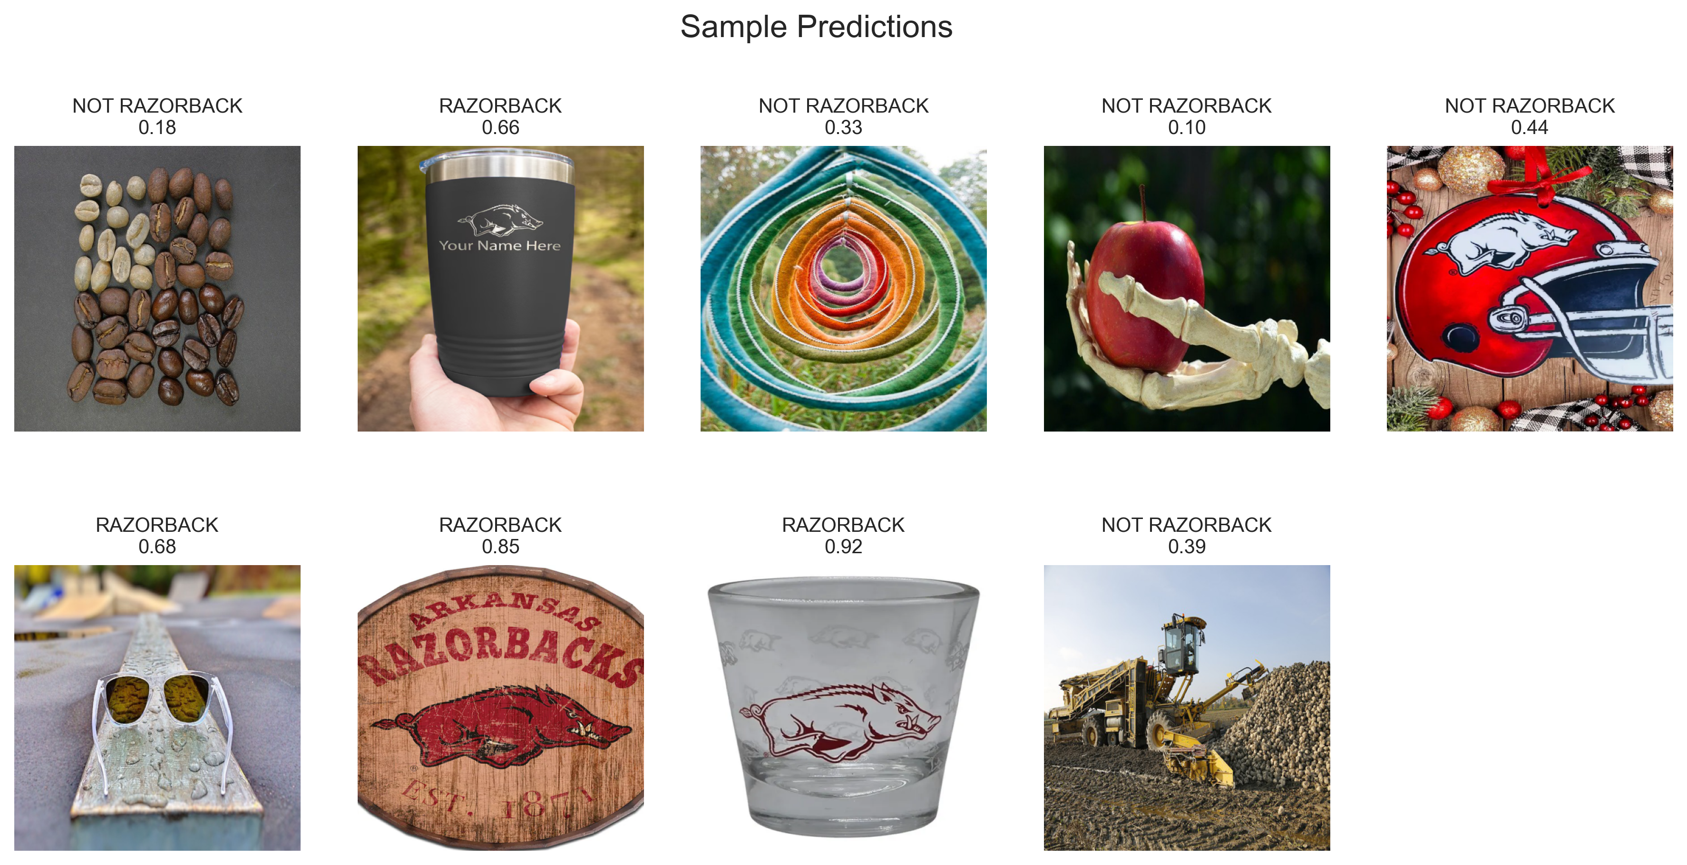
Sample Model Predictions

Slide 11
Reflection & Conceptual Questions
1. Dataset Creation & Splitting
We created the dataset manually by organizing images into two folders:
Razorback_Images/ for official logos and licensed branding
Non_Razorback_Images/ for random, non-logo images
The dataset was split into 70/15/15 (train/valid/test) to ensure enough training data while keeping unbiased evaluation sets.
2. Why This Architecture?
We selected a 4-block convolutional architecture because:
500×500 images require multiple layers to extract shapes
MaxPooling reduces memory cost
Dropout prevents overfitting
Simple, efficient structure appropriate for binary classification

Slide 12
Reflection & Conceptual Questions (Cont’d)
3. Monitoring & Mitigating Overfitting
Monitored:
Training vs validation loss curves
Training vs validation accuracy
ROC curve and confusion matrix
Overfitting was mitigated by:
Image augmentation
Dropout layer (p=0.3)
Smaller learning rate
Balanced dataset splitting
4. Future Improvements
Add more training data (more Razorback examples)
Use Transfer Learning (ResNet50, MobileNetV2)
Use better augmentations (color jitter, random resize crop)
Hyperparameter tuning (batch size, LR schedules)
Add regularization techniques (weight decay)

Slide 13
Conclusion
Custom CNN successfully classified Razorback logos
Achieved strong results with limited data
Demonstrated good generalization (AUC = 0.90)
Clear areas for future improvement

